Slide 1
CONSTRUCTOR
A constructor is a special member function whose task is to initialize the objects of its class.
It is special because its name is the same as the class name.
The constructor is invoked whenever an object of its associated class is created.
A constructor that accept no parameter is called the default constructor.

Slide 2
A constructor is declared and defined as follows:
class A
{
-
A(parameter list) // constructor declared
-
};
A:: A(parameter list)
{
-
}

Slide 3
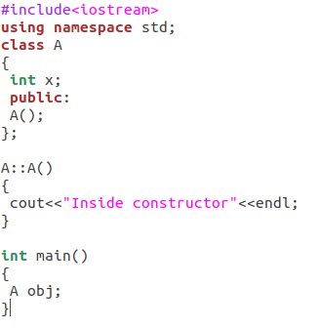

example

Slide 4
The constructor functions have some characteristics:-
They should be declared in the public section .
They are invoked automatically when the objects are created.
They don't have return types, not even void and therefore they cannot return values.
They cannot be inherited , though a derived class can call the base class constructor .
Like other C++ function , they can have default arguments,

Slide 5
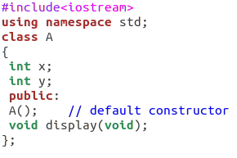
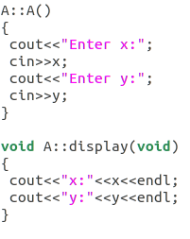
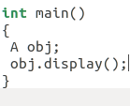

Example of default constructor:

Slide 6
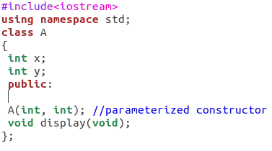
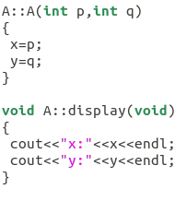
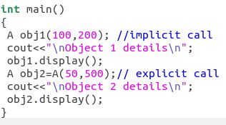
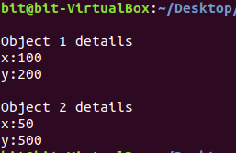
PARAMETERIZED CONSTRUCTOR

Slide 7
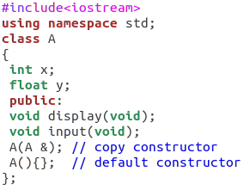
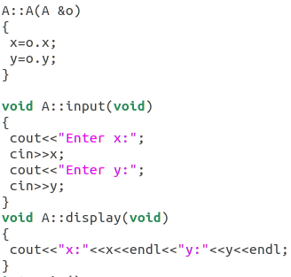
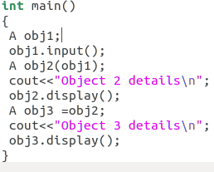
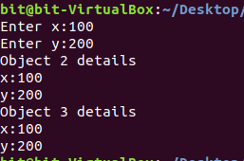
Copy CONSTRUCTOR A copy constructor is used to declare and initialize an object from another object.

Slide 8
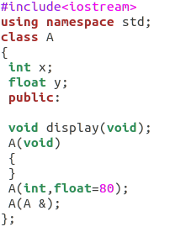
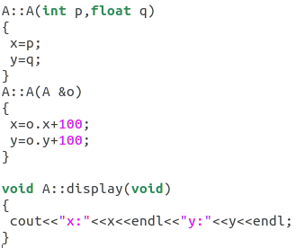
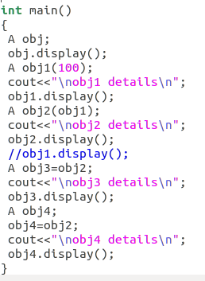
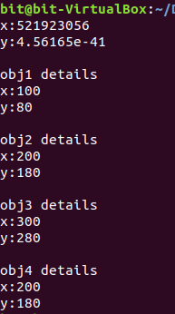
OVERLOADED CONSTRUCTOR

Slide 9
DESTRUCTOR
A destructor, as the name implies is used to destroy the objects that have been created by a constructor.
Like a constructor, the destructor is a member function whose name is the same as the class name but is preceded by a tilde.
A destructor never takes any argument nor does it return any value.

Slide 10
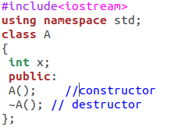
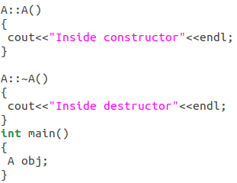

Ex.

